Slide 1
Sass - a better css

Slide 2
Table of contents
Sass - What and why
3. Sass or Scss
3. Features
4. Do it yourself

Slide 3
Sass - Why and What
What is Sass:
A css preprocessor
Compiles sass and scss syntax into css syntax
Why you should use Sass:
Maintainability and readability of your css code.

Slide 4
2. Sass vs Scss (syntax)
Sass:
identation istead of brackets
newlines instad of semicolons
Scss:
new version of the sass syntax (but both have the same features)
stays true to css basic syntax

Slide 5
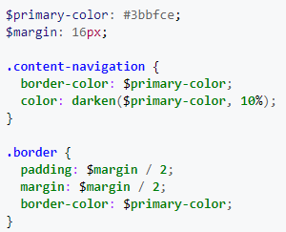
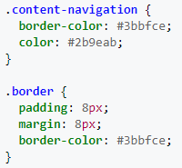
3. Features
Variables
Define and reuse variables in your code with the $ sign
Scss: Compiles to:

Slide 6
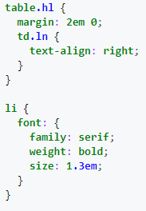
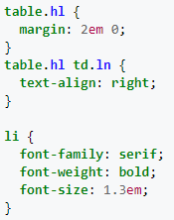
3. Features
Nesting
asign style rules to all child elements in one go
Scss: Compiles to:

Slide 7
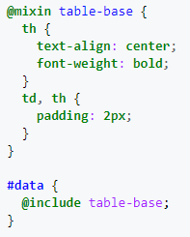
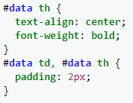
3. Features
Mixins
reuse parts of you code at will
Scss: Compiles to:

Slide 8
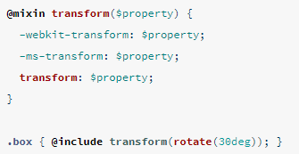
3. Features
Mixins
reuse parts of you code at will
Mixin with parameter:

Slide 9
4. Do it yourself
Basic test:
Open index.html in your browser
Run compile_scss.bat
Reload index.html in your browser - your font sould be red now!
Test the other features:
Try nesting some style rules
Create a mixin to rotate an html element and use it on multiple objects with different degrees of rotations
Experiment, clean up an old css file with scss
Check https://sass-lang.com/guide and ask me for help!

